Slide 1
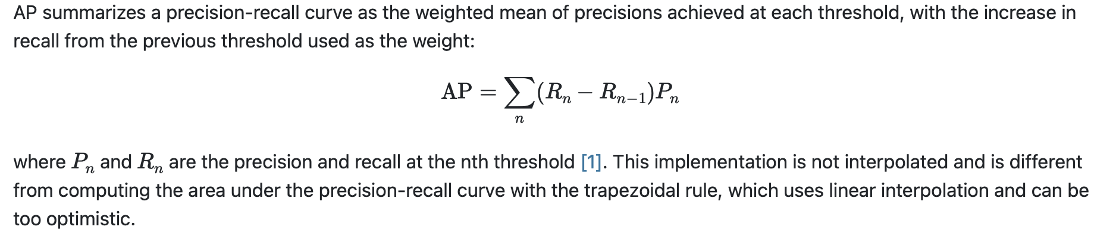
Degree-Accuracy
degree | Test AP | Test AUC | Pos Acc | Neg Acc
small | 0.7390 | 0.7275 | 0.4 | 0.9
average | 0.8968 | 0.8821 | 0.665 | 0.9
large | 0.9533 | 0.9464 | 0.795 | 0.96
small: extract the first 20 vertices with smallest degree
large: extract the last 20 vertices with largest degree
average: extract vertices with degree in [avg_degree-1, avg_degree+1]

Slide 2
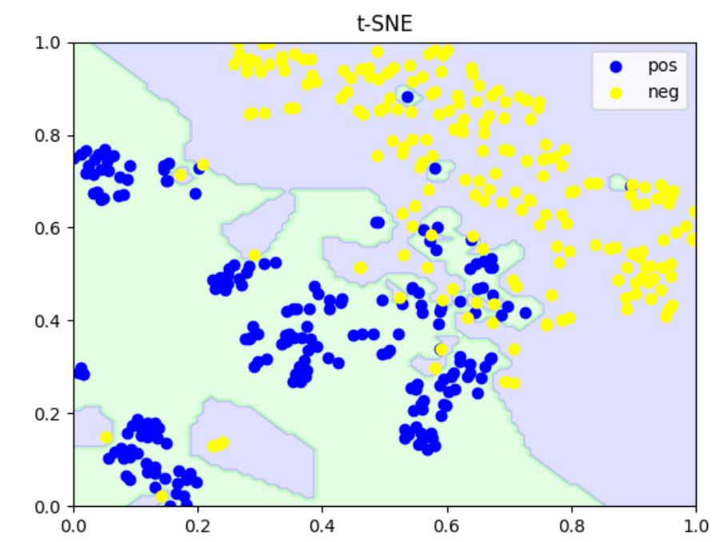
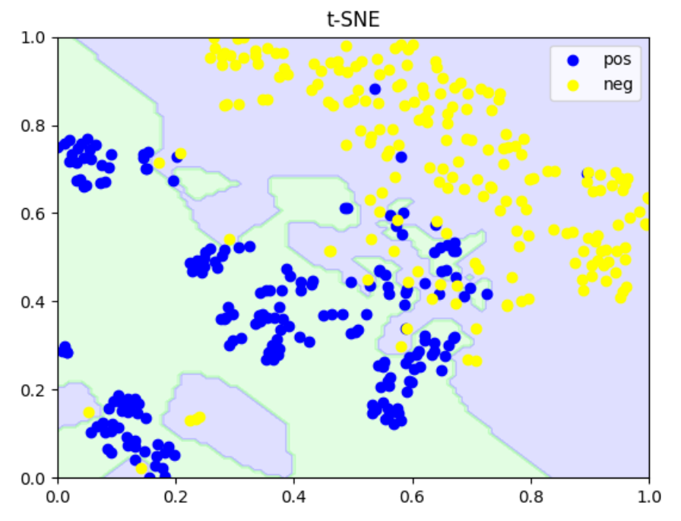
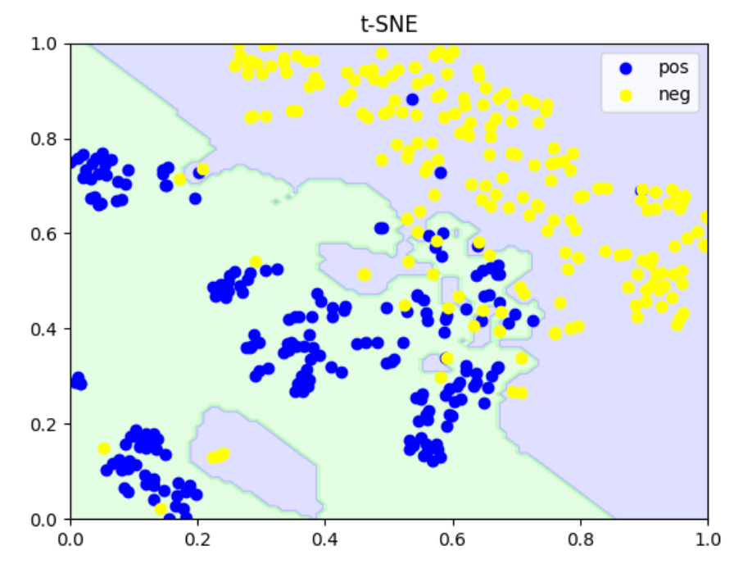
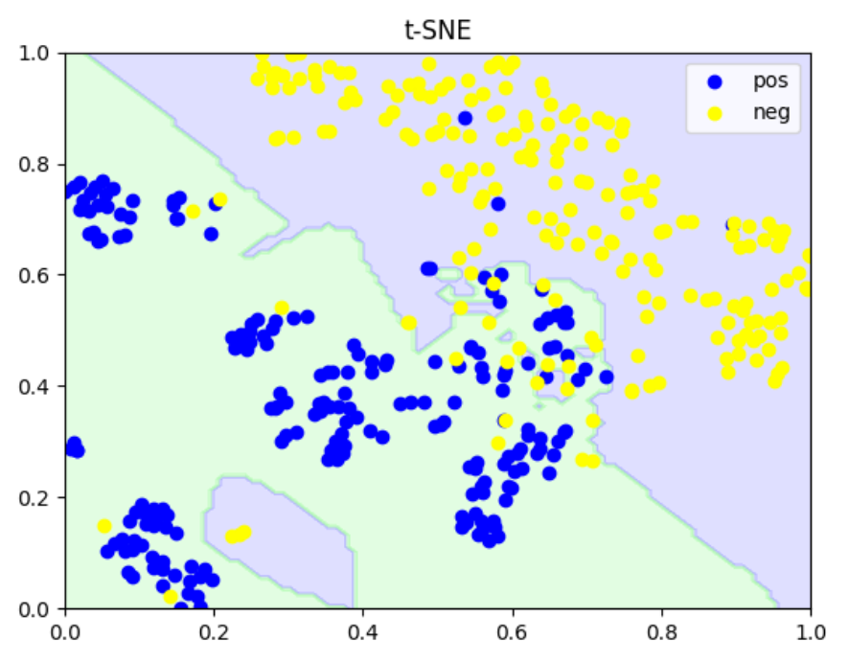
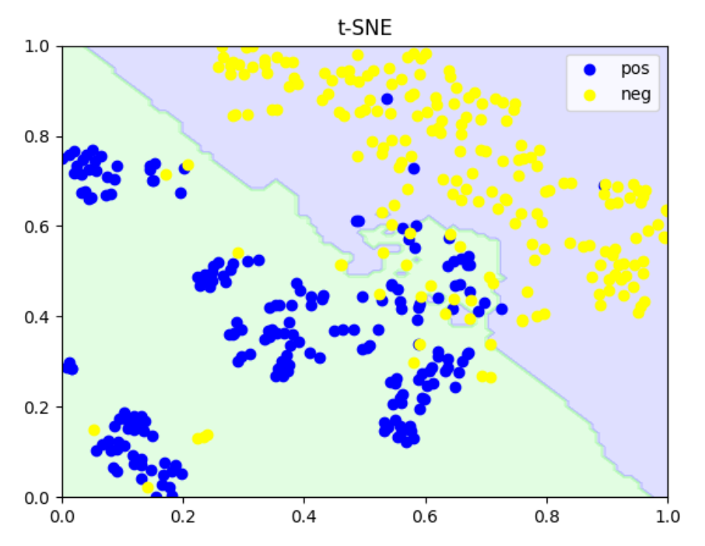
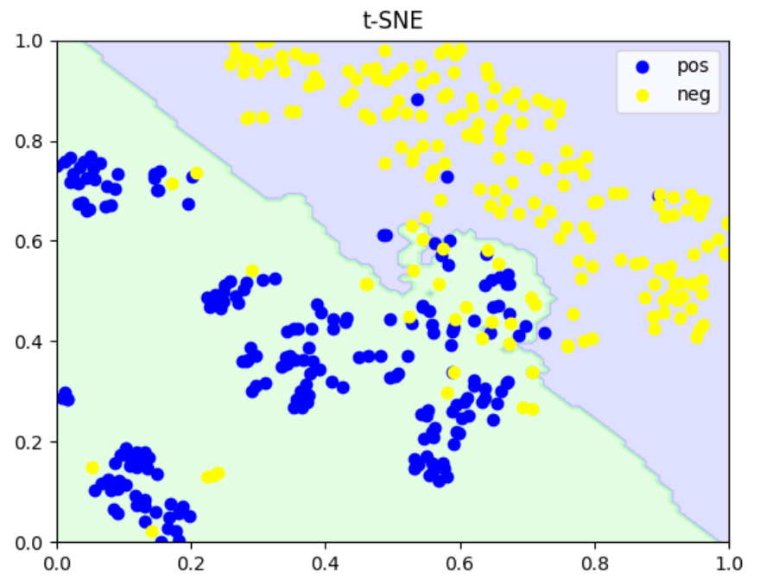
Decision boundary
KNN
k=1
k=2
k=3
k=5
k=7
k=9

Slide 3
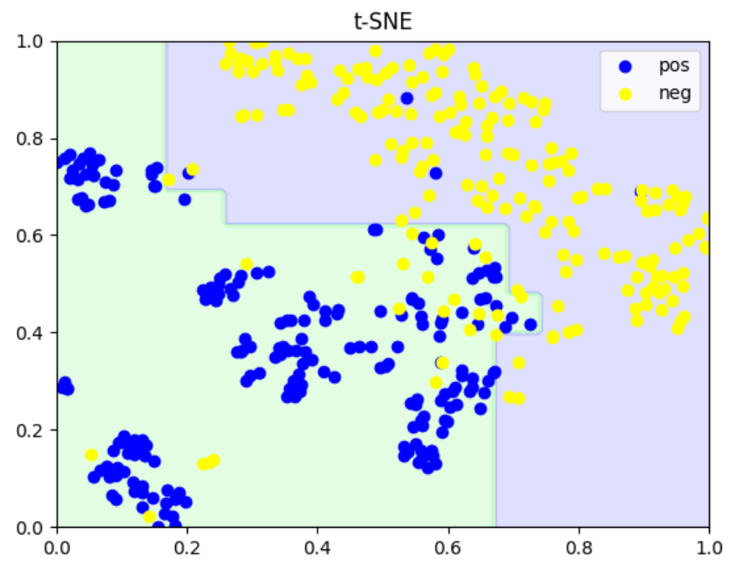
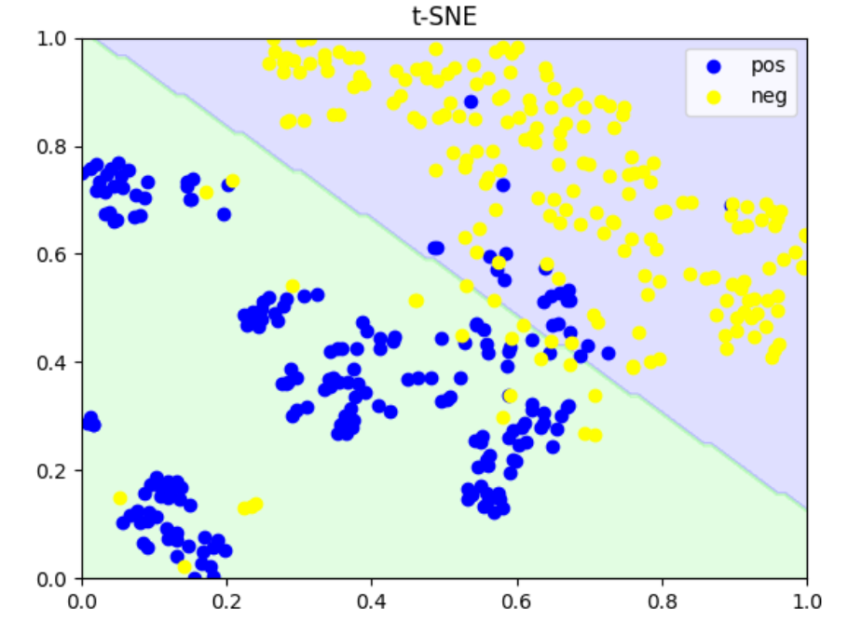
Decision boundary
Decision Tree
SVM

Slide 4
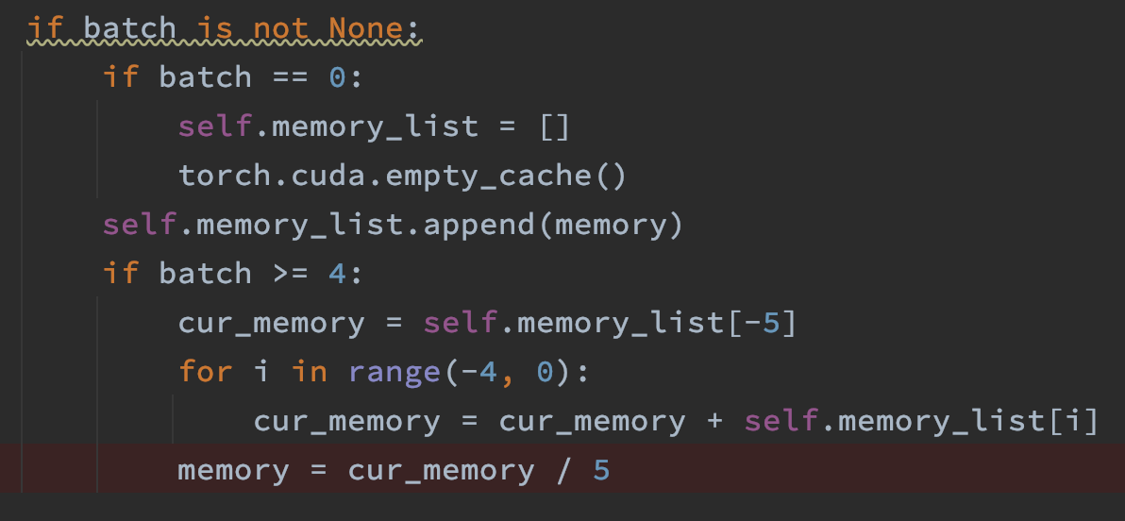
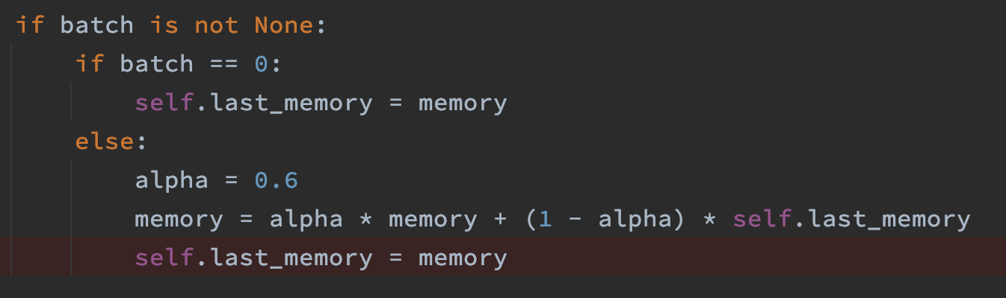
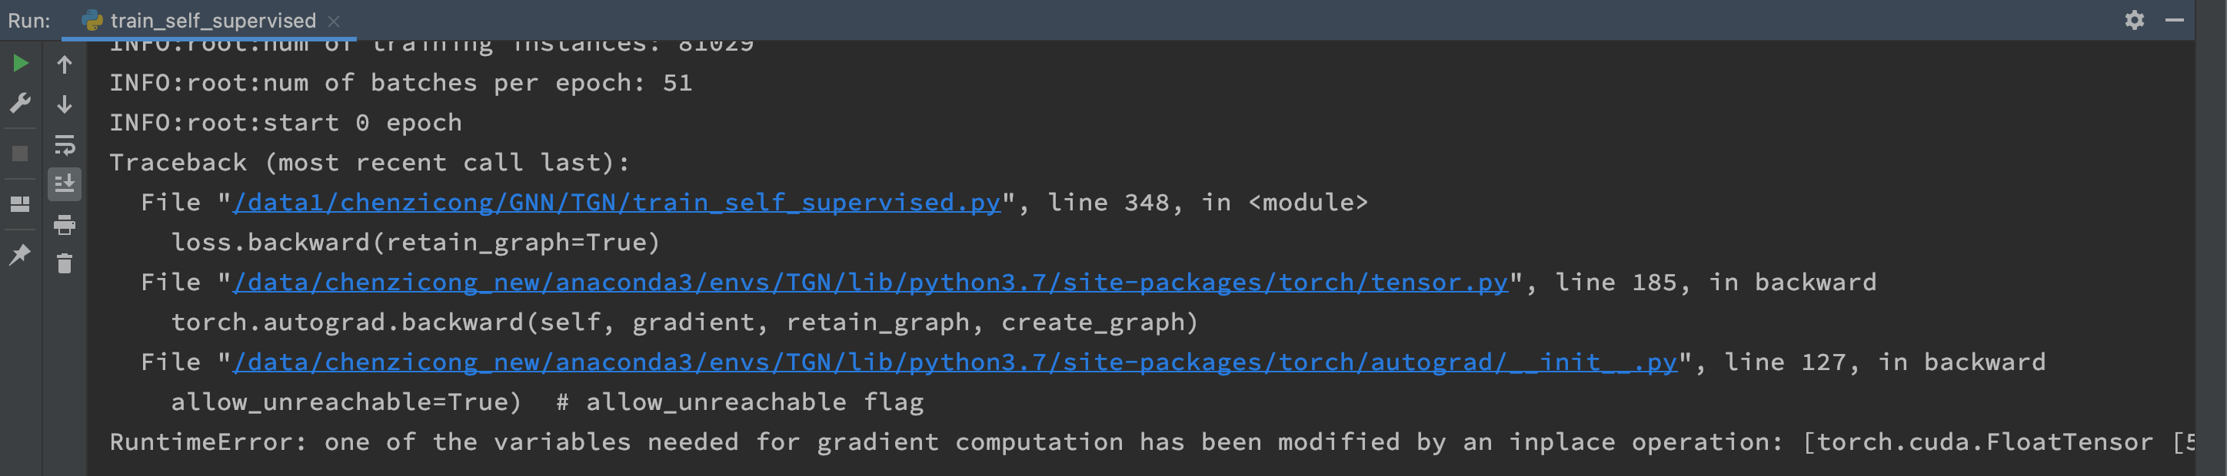
Time-series data smoothing
rolling mean
Exponential smoothing
RuntimeError: one of the variables needed for gradient computation has been modified by an inplace operation: [torch.cuda.FloatTensor [516]] is at version 2; expected version 1 instead. Hint: enable anomaly detection to find the operation that failed to compute its gradient, with torch.autograd.set_detect_anomaly(True).

